Slide 1
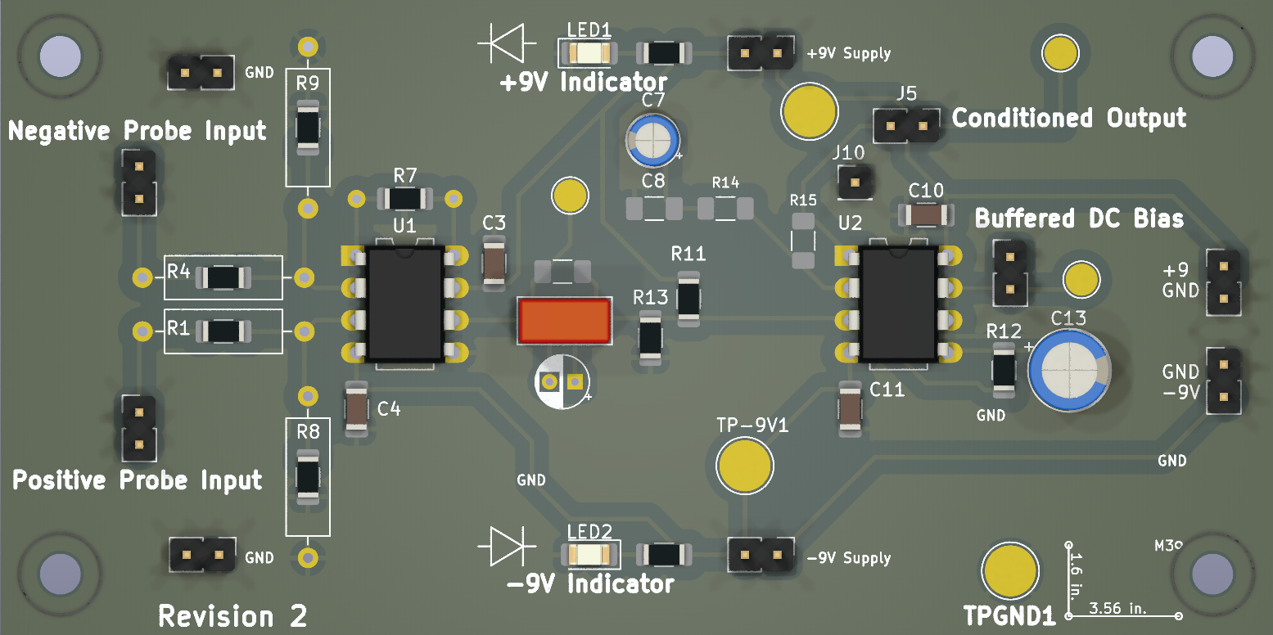
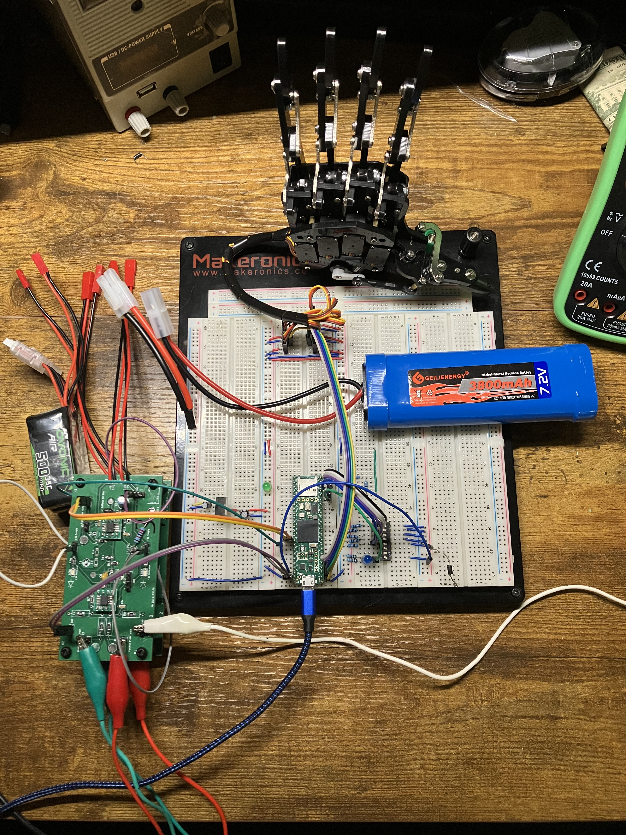
Motorized Robotic Hand Controlled Hand by Surface Electromyography (sEMG)
Authors: Jay E. Bernstein, David J. Mora, Juan R. Ortiz; Advised by Dr. Norali Pernalete
Block Diagram
Abstract
The objective of this project was to discover the fundamentals of signal acquisition and processing, in a situation requiring extremely precise hardware requirements in order to achieve both common mode signal rejection and extremely high gain. Because this is a medical device, considerations of safety had to be made as well. The final product is a printed circuit board designed around the Texas Instruments INA82x that handles differential gain, with input resistance to limit the shock hazard were a fault to occur. The amplified input signal is processed so that a microcontroller is able to determine what command the signal is closest to.
MCU (Teensy 4.1)
Amplifier
Capture 1000 Samples at 40kHz with ADC
Protected Inputs to Instrumentation Amplifier IC
Surface sEMG
Normalize, Rectify, and Amplify ADC Input
Robotic Hand
AC Coupled and Buffered Output
Finger Detection Algorithm
Block Diagram showing the acquisition and processing chain for the EMG signals. Muscle activations are sent into the amplifier, which is conditioned so that the onboard ADC of the Teensy can acquire it properly. A 40kHz periodic sample is taken, processed slightly, and used to make a decision on the activation of the robotic hand
Hardware/Software Overview
The hardware required to implement the current version includes the Teensy 4.1, a development board with an ARM Cortex-M7 600MHz MCU, which has a DSP instruction set. 3 batteries are used to power the system, with only 2 required. Two matched Li-ion 11.1V batteries are used to power the positive and negative rails of the amplifier, and a 7.4V NiMh battery is used to power the MCU and servos in the hand, with conditioning from a 7805. The hand used is a COTS robotic hand sold on Amazon, with 9g 6V anti-blocking servos. The amplifier consists of three stages. The front-end has high value resistors to reduce shock hazard for the user, as well as biasing resistors to increase the performance of the instrumentation amplifier. The amplifier is configured for 2000x gain. The middle stage is ac coupled to a resistor divider, which sets the dc midpoint of the signal at approximately 2 volts. This is acquired by two separate circuits attached to a single LF353. One op amp is used as a signal buffer stage, which is layed out so that if additional gain in the buffer stage is required, the circuit can be easily modified. The other integrated op amp is used as a low pass filter which outputs the dc midpoint value of the conditioned signal, to improve processing and check for issues with the circuitry.
The code was developed in Arduino IDE using built in libraries from Arduino and Teensy. The sig Our software was developed using the Arduino IDE as the microcontroller was compatable. When a signal is detected using the electrodes, it then flows into our amplifier and out into our microcontroller in which we have a control system. The control system works by first detecting, normalizing, rectifying, and amplifying the signal. We then generate an arbitrary peak value using our filtered signal. This arbitrary peak acts as a peak detector in some way, but for our control system it will be used to in conjuction with a distance calculation to activate threshold to control the hand. The individual fingers on our hand are stored in an array, but we are also utilizing a 3x5 array to store the current and previous position of each finger as well as an enable value. Our software was modified to accomadate for two different probes that would allow us to easily differentiate thresholds between fingers. Once a threshold is met or detected, the respective finger/s will be enabled and allowed to move to its specified position. If more than one condition is met, our software allows for multiple movements. Once a condition is no longer met it reverts back to its initial state and waits for the user. An aditional feature that was implemented was a debug mode in order to acess that each finger functions properly in the case something goes wrong.
﻿
A render of the revision 2 amplifier PCB, altered from the manufactured version for clarity. Large silkscreen text is used to emphasize separate regions of the board
Recorded Vs Processed Signal From Probe
Clench
Sensor 2 Processed Amplitude
Ring
Index
Measured Point
Middle
Thumb
Pinky
Gain Comparison of Probe Board Revisions
Open Hand
Sensor 1 Processed Amplitude
Picture of prototype project. Pictured bottom left: stacked amplifier PCBs. Middle left: Li-Ion batteries. Top center: robotic hand and wiring harness. Middle right: NiMh battery. Bottom center: Teensy 4.1
Conclusion
Compare amplifier characteristics between discrete inamp, breadboarded ina129, and assembled hardware. Design tradeoffs made, such as removing 60hz HP filter. Nature of MUAPs, long spacing and frequency components. Power supply noise rejection and grounding issues with amplifier. Conclude with what went right what went wrong, what to improve next time
Table 1 (top) displays the output of the amplifier in blue, and the processed signal in orange. The rectification is the most prominent component, but digital filtering and gain also occur.
A diagram showing how a distance based trigger determination is made. Signal amplitudes for predetermined actions are decided on by manual configuration or software. The probes constantly acquire new windows, and a maximum processed amplitude of each probe is collected for each window. The scalar distance between the measured value and preset actions is taken, and the action with the lowest distance is activated
References
Michael Haidar, Jason Hwang, and Srikrishnaa Vadivel, “EMG Robotic Hand,” Cornell University, 2016. Accessed: Apr. 21, 2024. [Online]. Available: https://people.ece.cornell.edu/land/courses/ece4760/FinalProjects/f2016/mh2298_jyh37_sv376/mh2298_jyh37_sv376/mh2298_jyh37_sv376/index.html
6mm 8mm 10mm 20mm 30mm. 32Point = 0.5 inch High

Slide 2
Clench
Open
Sensor 2 Processed Amplitude
Ring
Index
Measured Point
Middle
Open
Thumb
Pinky
Open Hand
Sensor 1 Processed Amplitude
Table 2 (bottom) displays the difference in frequency response of the two revisions. The difference in high frequency performance is due to changing the instrumentation amplifier IC from INA823 to INA828.

